Slide 1
QUICK GUIDE TO CHARITABLE REPORTING IN CLMS
Presented by Government Relations Committee for Maryland, Delaware and District of Columbia Elks Association

Slide 2
QUICK GUIDE
It’s amazing just how much of the Lodge’s Charitable work is eligible to be reported in CLMS. This Presentation has some general instructions on the what, when, and how to report this information. You may find shortcuts of your own and it is encouraged that you share them with other Secretaries, State Chairpersons and the Membership.
Contact your State Chair or Grand Lodge Area Chair of Government Relations with questions.

Slide 3
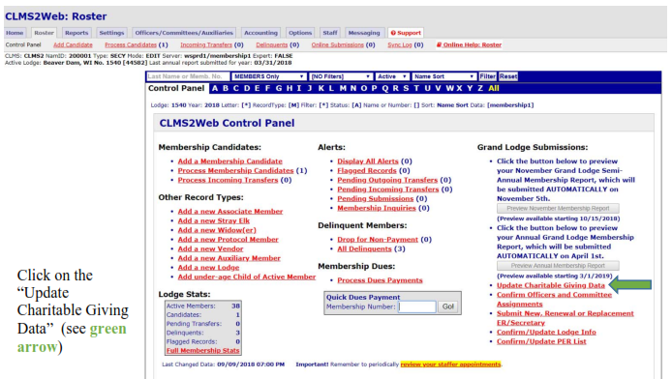
Updating Charitable Giving

Slide 4
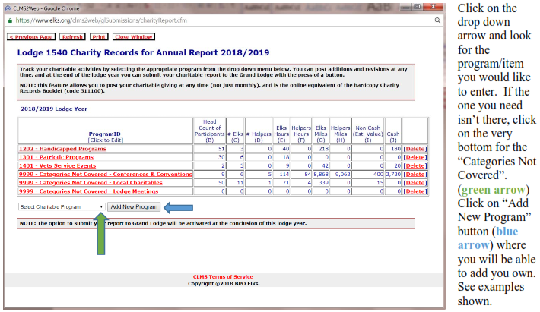
Updating CHARITABLE GIVING

Slide 5
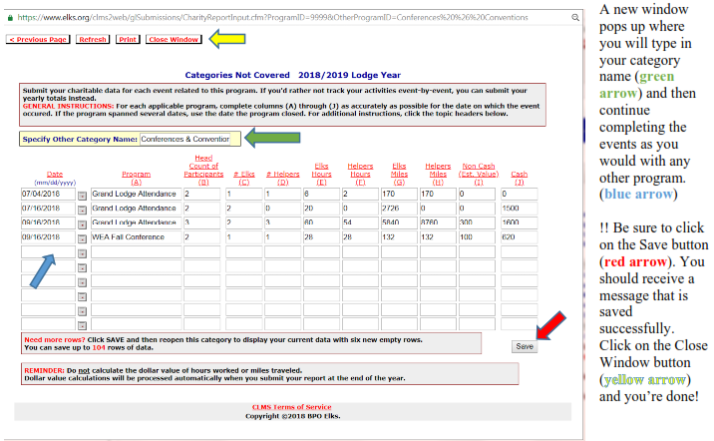
UPDATING CHARITABLE GIVING

Slide 6
GENERAL GUIDELINES
The event chairpersons should be submitting the form to the Secretary no later than two weeks after the event end date.
If it’s a season long program, i.e. monthly cookout during the summer, the event chair can keep a running total until the season is over or every 3 months.
Report submission should not go longer than three months – and NEVER cross Lodge Years.
All reports should be submitted to the Secretary by mid-March so there is time to enter and verify the information before year end.

Slide 7
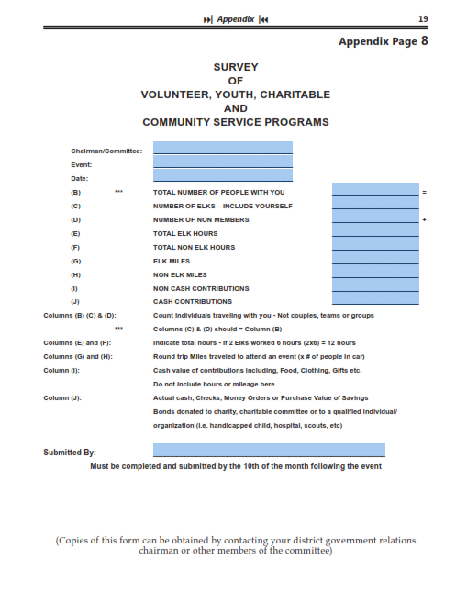
CHARITABLE WORKSHEET
This worksheet should be completed and submitted within two weeks of every Charitable Event.

Slide 8
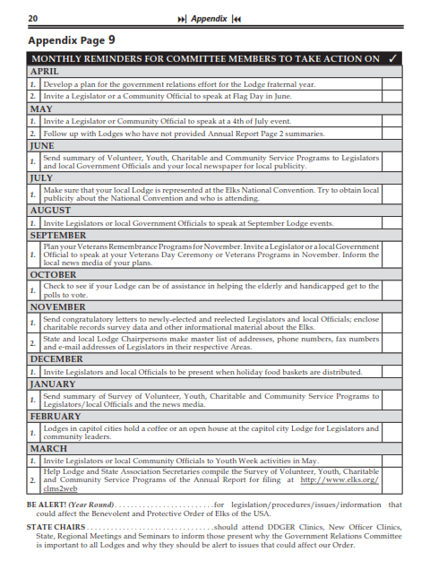
MONTHLY REMINDERS
Committee Members need reminders too. Government Relations in how we promote our great work.

